Slide 1
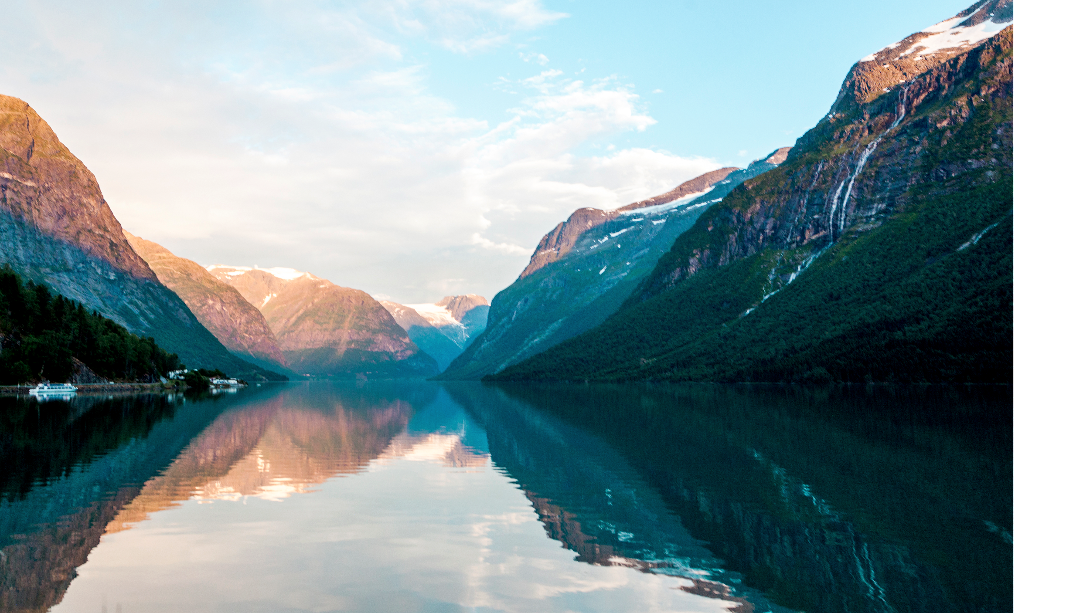
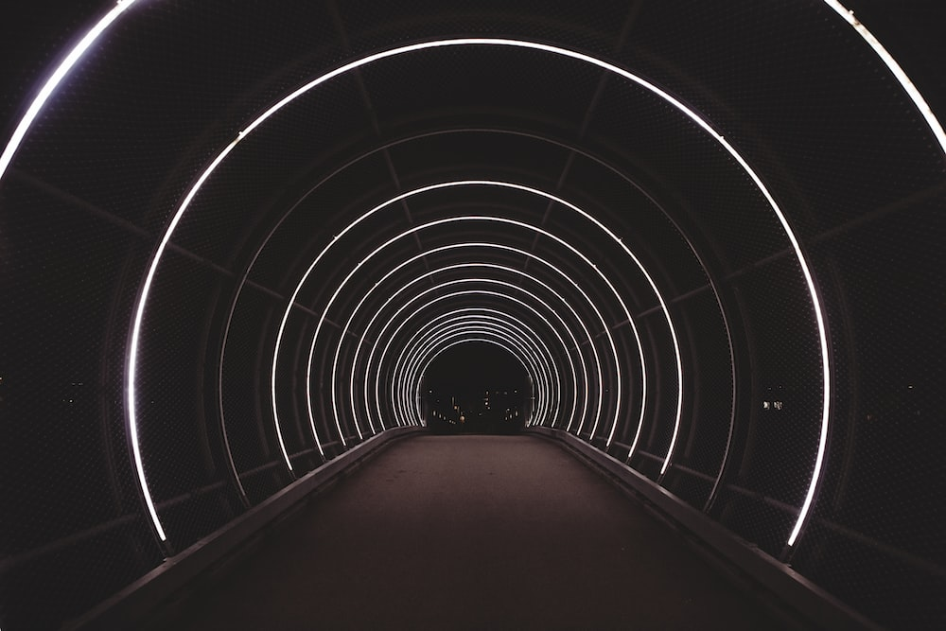

ViShield
Protects you from unwanted images/videos
Er Jie Yong
Notes:
Hello everyone! It's the last presentation of the day. My name is Jie Yong and I hope I can keep you entertained. I'll like to start off with an obvious question: Who does not use the internet? Nobody right? Then my project would be very applicable to you.

Slide 2

The INTERNET
Useful IMAGES
Useful VIDEOS
Useful TEXT
Notes:
The internet is basically the foundation of our life and work.
If you use it properly, you can find …

Slide 3
Phobia Triggers A phobia is an anxiety disorder defined by a persistent and excessive fear of an object or situation
Fear of amphibians
Fear of clowns
Fear of insects
Batrachophobia
Coulrophobia
Entomophobia
Arachnophobia
Cynophobia
Fear of spiders
Fear of dogs
Societal Issues
Hate Speech
Pornography
Violent Img/Vid
Notes:
However, it is also filled with a lot of images and videos that people don’t like.

Slide 4
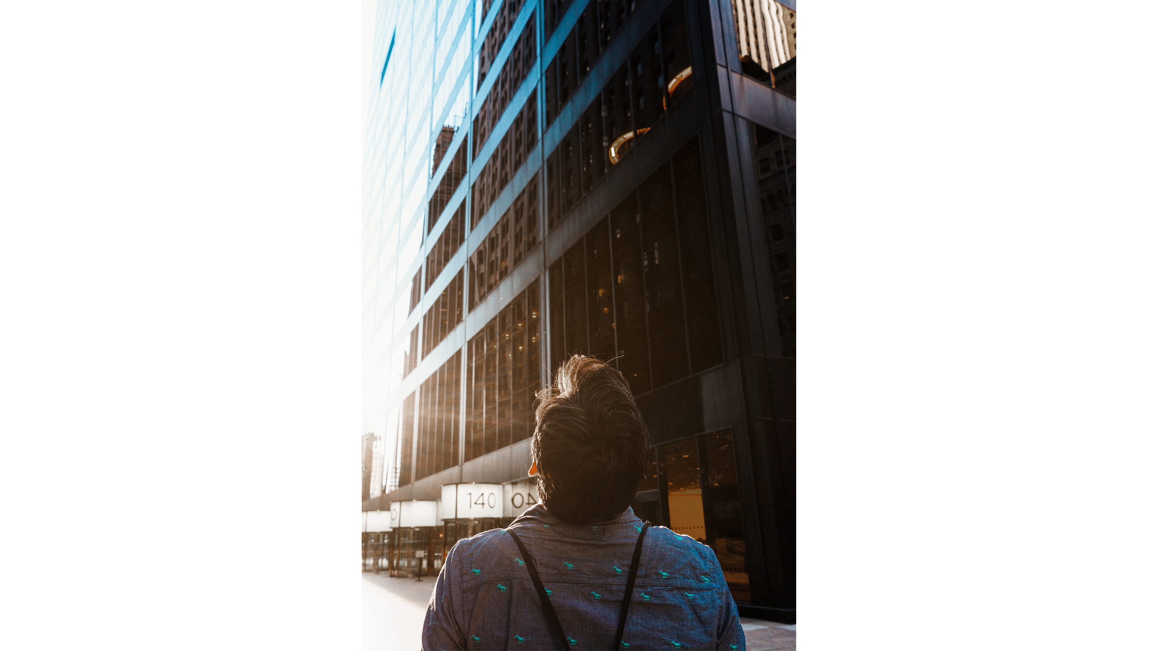
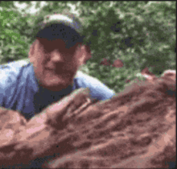
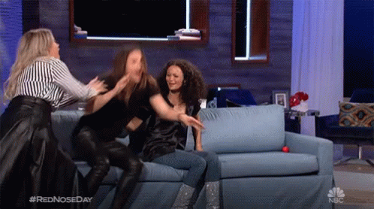
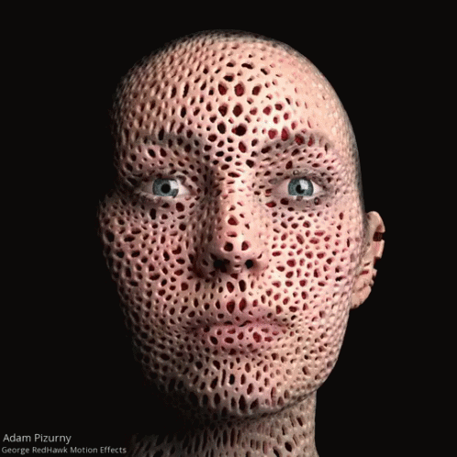
Snakes
IMAGINE you are browsing the internet
Trigger Warning!
Trypophobia

Slide 5
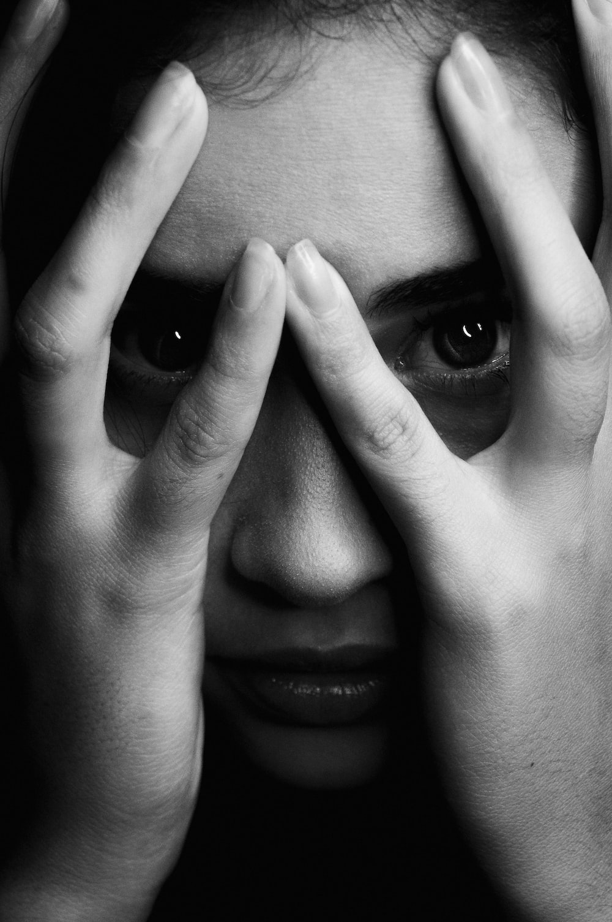
Symptoms / Effects
Short term
Sweating
Chills
Shortness of breath
Nausea
Headaches
Numbness
Confusion or disorientation
Loss of appetite
Long Term
Constant Anxiety
Panic Attack
Suicidal (Hate Speech)
Change in Character & Values (Violence and pornography)
Notes:
There’s also short term and long term effect.
As a matter of fact from observing my wife, there would be a loss of appetite
https://www.nhs.uk/mental-health/conditions/phobias/symptoms/#:~:text=Phobias%20can%20limit%20your%20daily,causes%20them%20fear%20and%20anxiety.

Slide 6

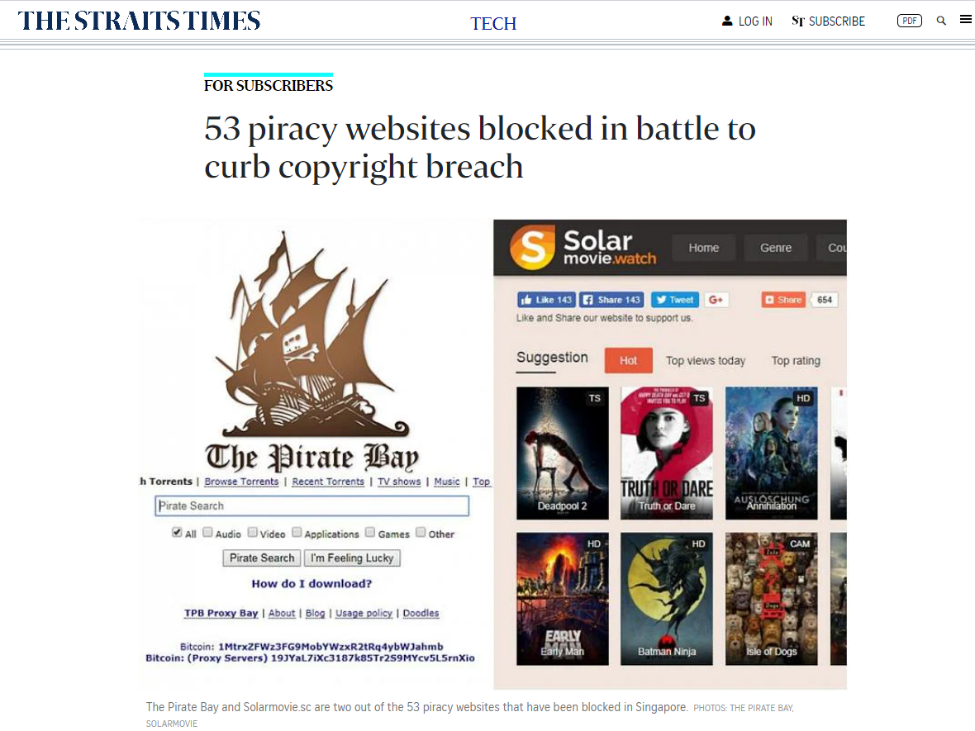
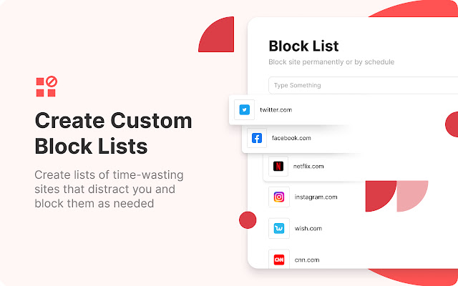
Current Solution: URL Blacklist
Government Blacklist
Open Sourced / Custom URL Hostlist
Whack-a-mole
Notes:
There are current solutions out there

Slide 7
What about everyday sites?
Facebook
Instagram / TikTok
YouTube
StraitsTime / ChannelNewsAsia
Hardwarezone
/ Reddit
Notes:
Then there’s the problem of everyday sites

Slide 8
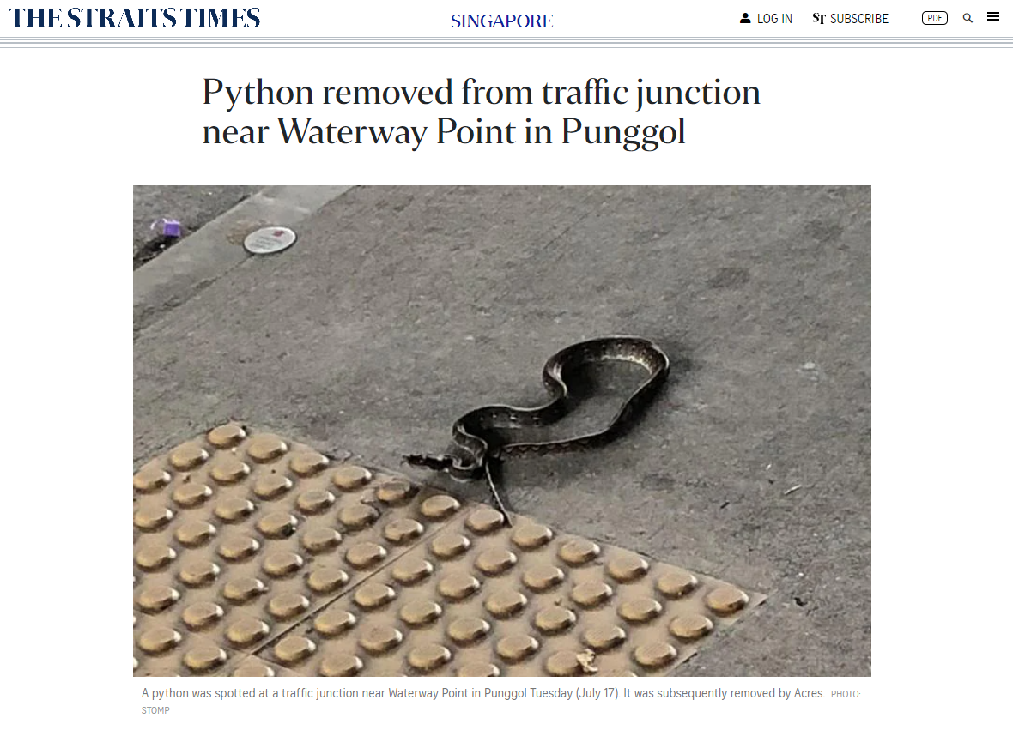
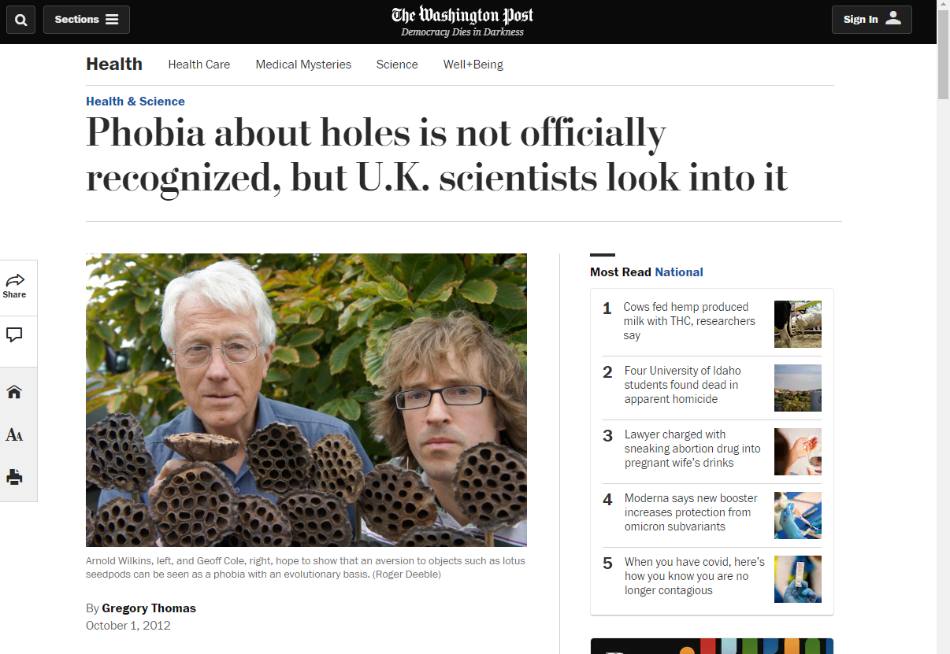
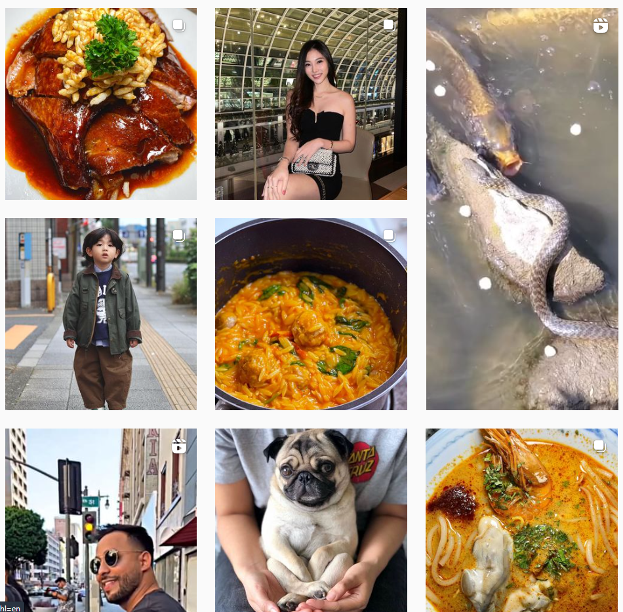
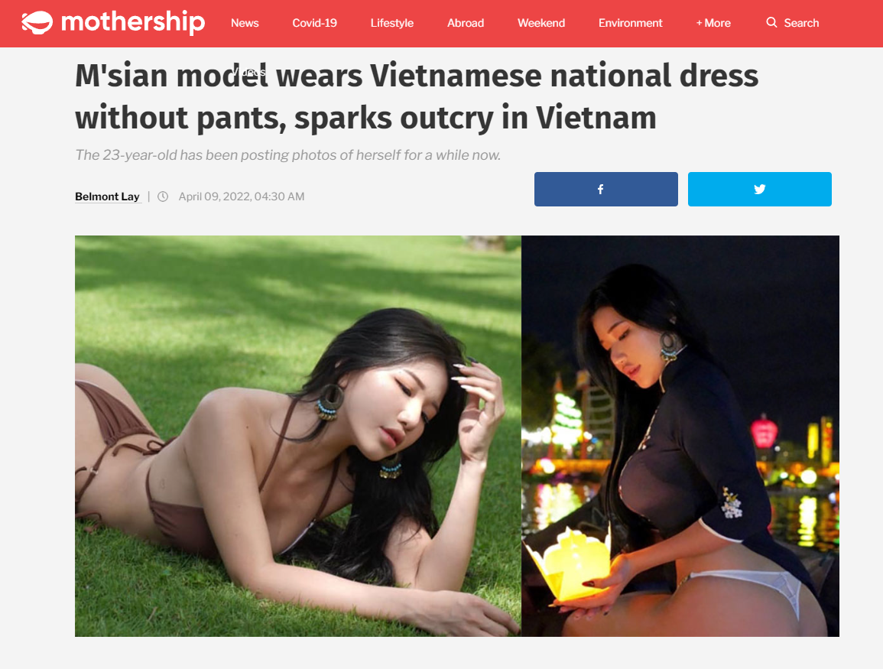
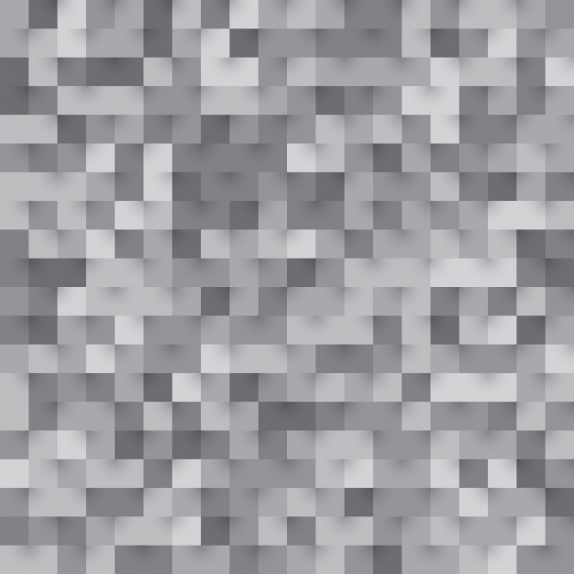

Everyday Sites
Notes:
But you are still potentially exposed to unwanted images such as snakes, girls without pants and holes even for such websites!

Slide 9
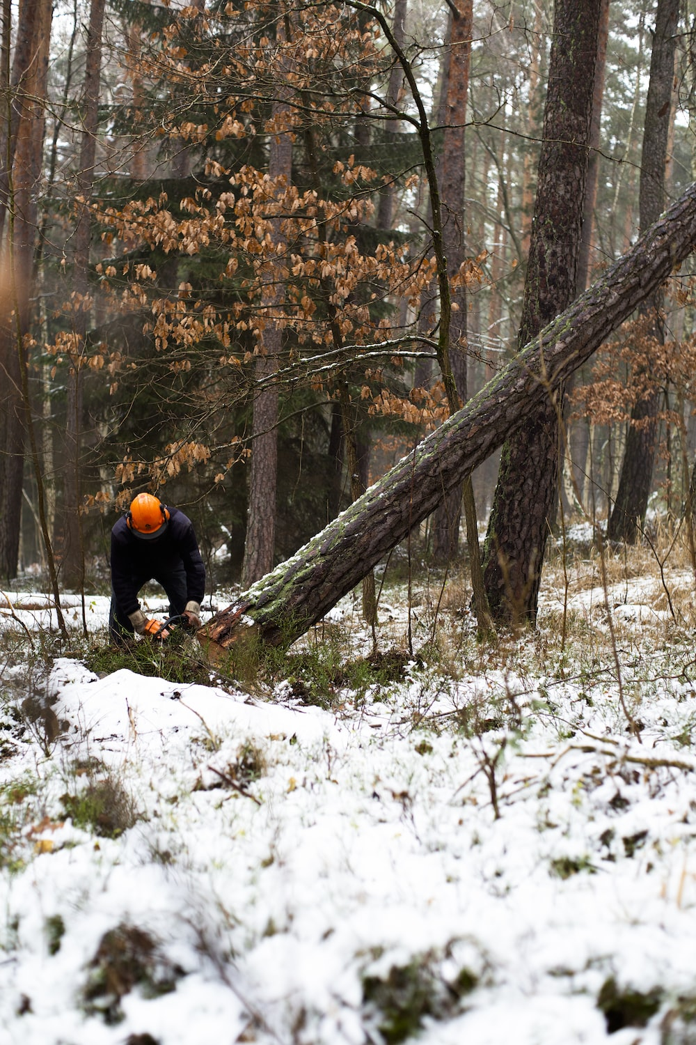
What can we do?
How can we prevent users from getting bombarded by undesirable Images and Videos?

Slide 10
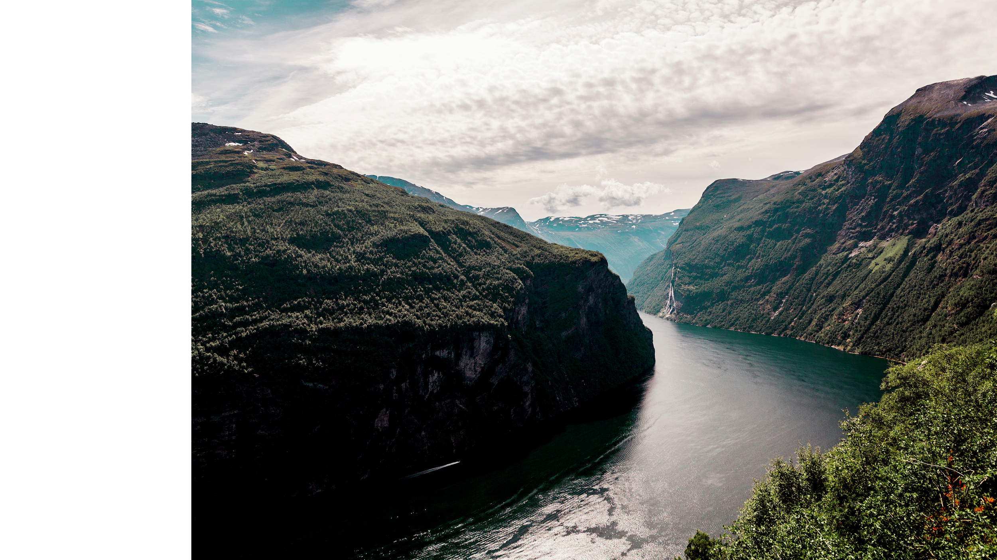
ViShield
Machine Learning Incorporated
Notes:
Introducing ViShield! Where we incorporates machine learning into our products.

Slide 11
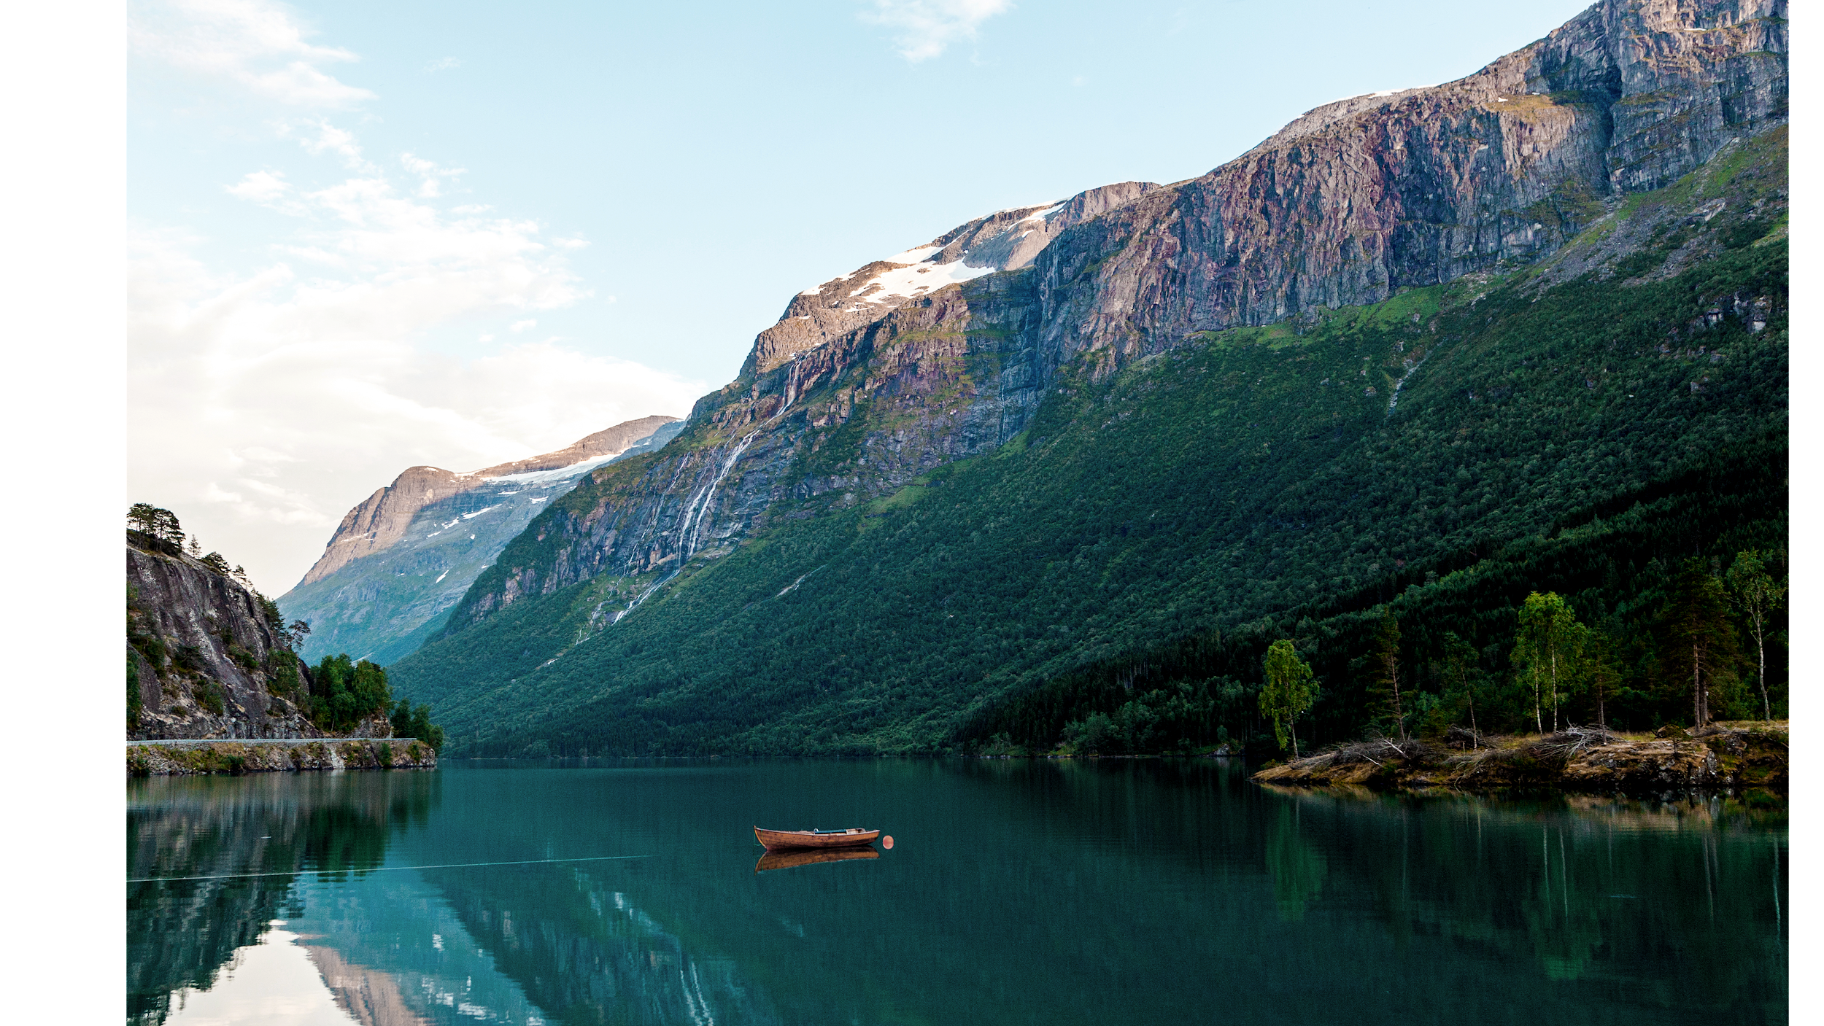
Our Capabilities
Real-time Image Filter
Streamlit Post-Processing Image Filter
Streamlit Post-Processing Video Filter
(Image Classification)
Hide images and gif that you choose not to see.
Dogs
Cats
Snakes
Trypophobia
(Instance Segmentation)
Identify images of snakes by pixel and filter them out
(Instance Segmentation)
Identify images of snakes in a video by pixel and filter them out
Chrome Extension
Streamlit Web App

Slide 12

Computer Vision
Convolutionary Neural Network
Fully Connected Network
Extracting Features
Learning Relationships

Slide 13
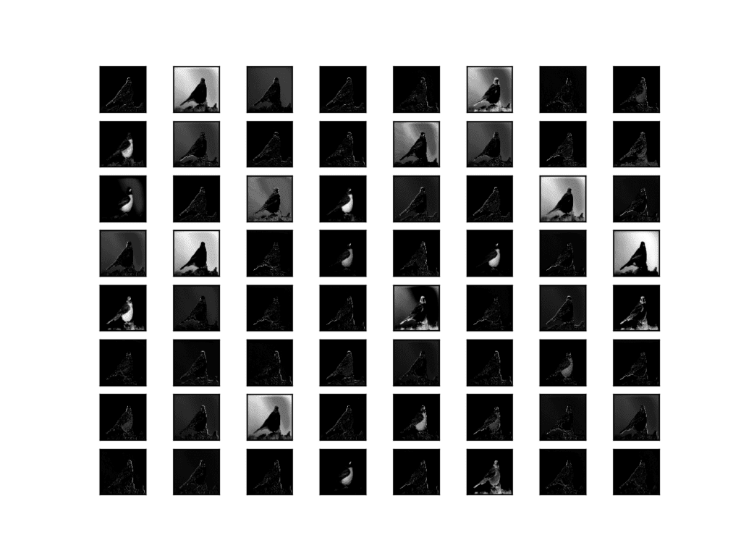
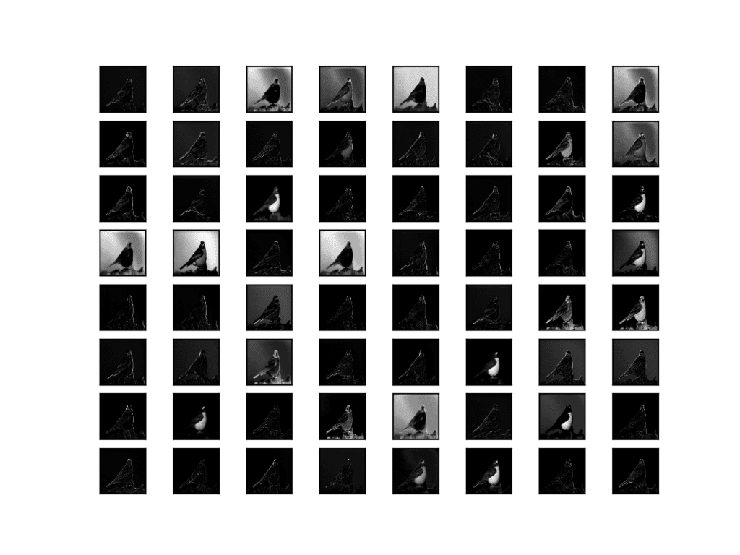
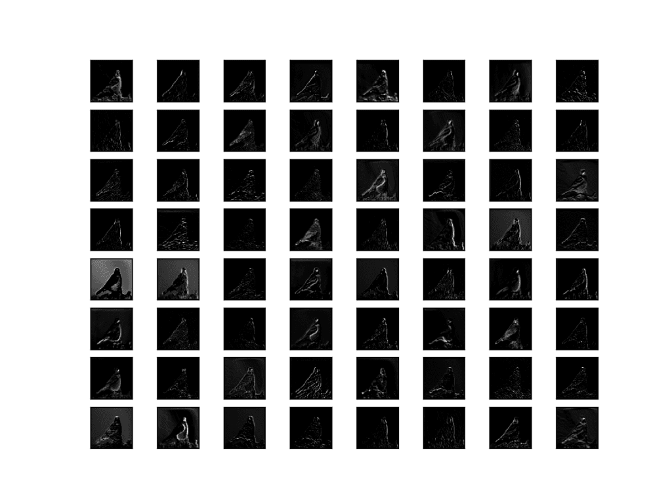
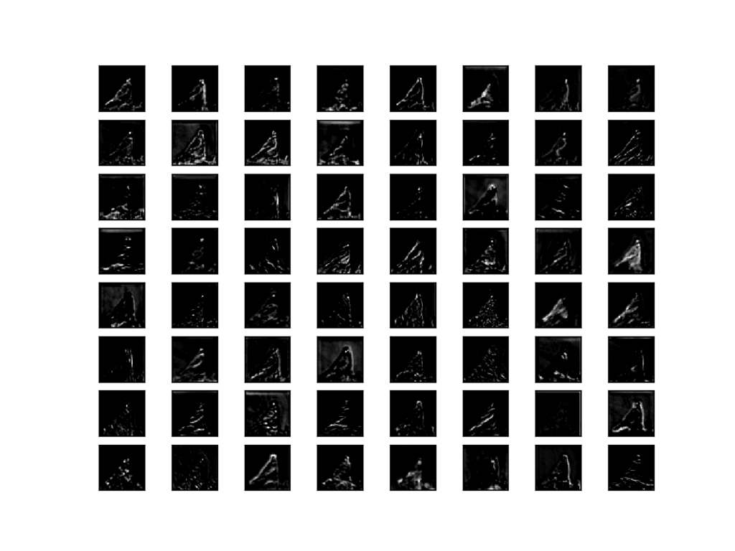
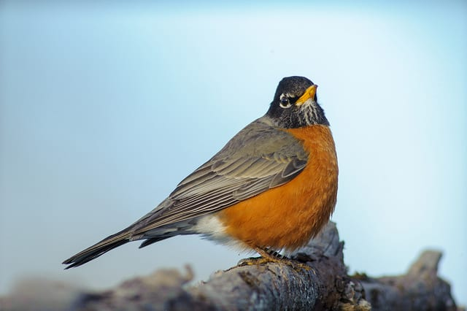
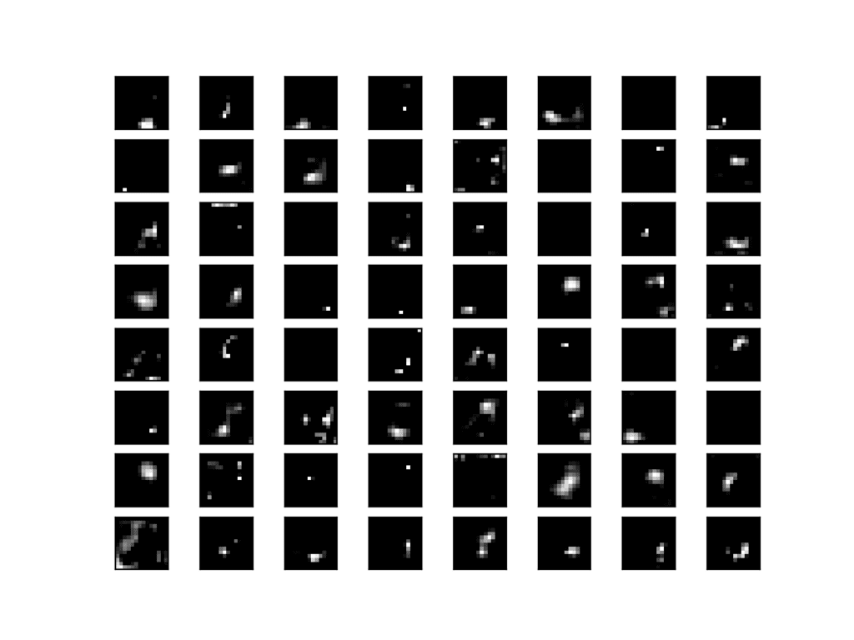
Convolutional Neural Network Feature Selection
CNN Layer 1
CNN Layer 2
CNN Layer 3
CNN Layer 4
CNN Layer 5
Extract & Generalise

Slide 14
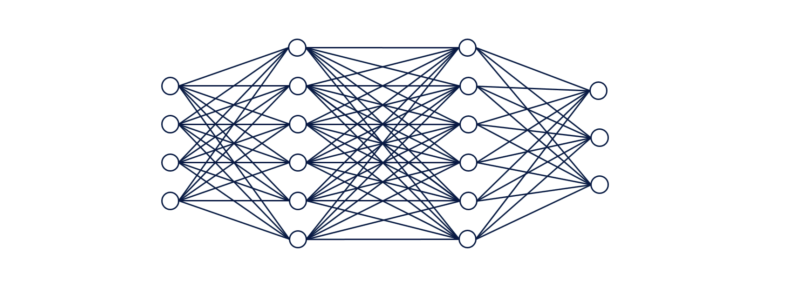
Fully Connected Network Relationship → Classification

Slide 15
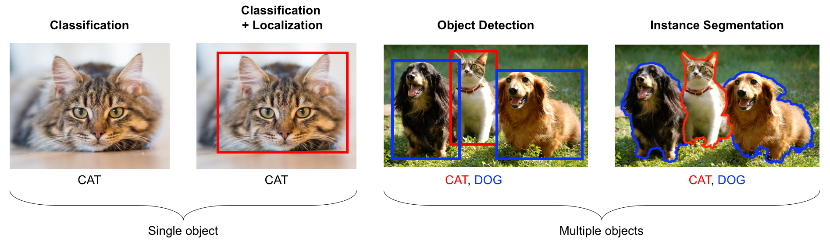
Computer Vision
Notes:
Before i show you the products, i would just like to share that our products are focused on computer vision. In particular image classification and instance segmentation.
Object of interest

Slide 16
Our Capabilities
Real-time Image Filter
Streamlit Post-Processing Image Filter
Streamlit Post-Processing Video Filter
(Image Classification)
Hide images and gif that you choose not to see.
Dogs
Cats
Snakes
Trypophobia
(Instance Segmentation)
Identify images of snakes by pixel and filter them out
(Instance Segmentation)
Identify images of snakes in a video by pixel and filter them out
Chrome Extension
Streamlit Web App

Slide 17

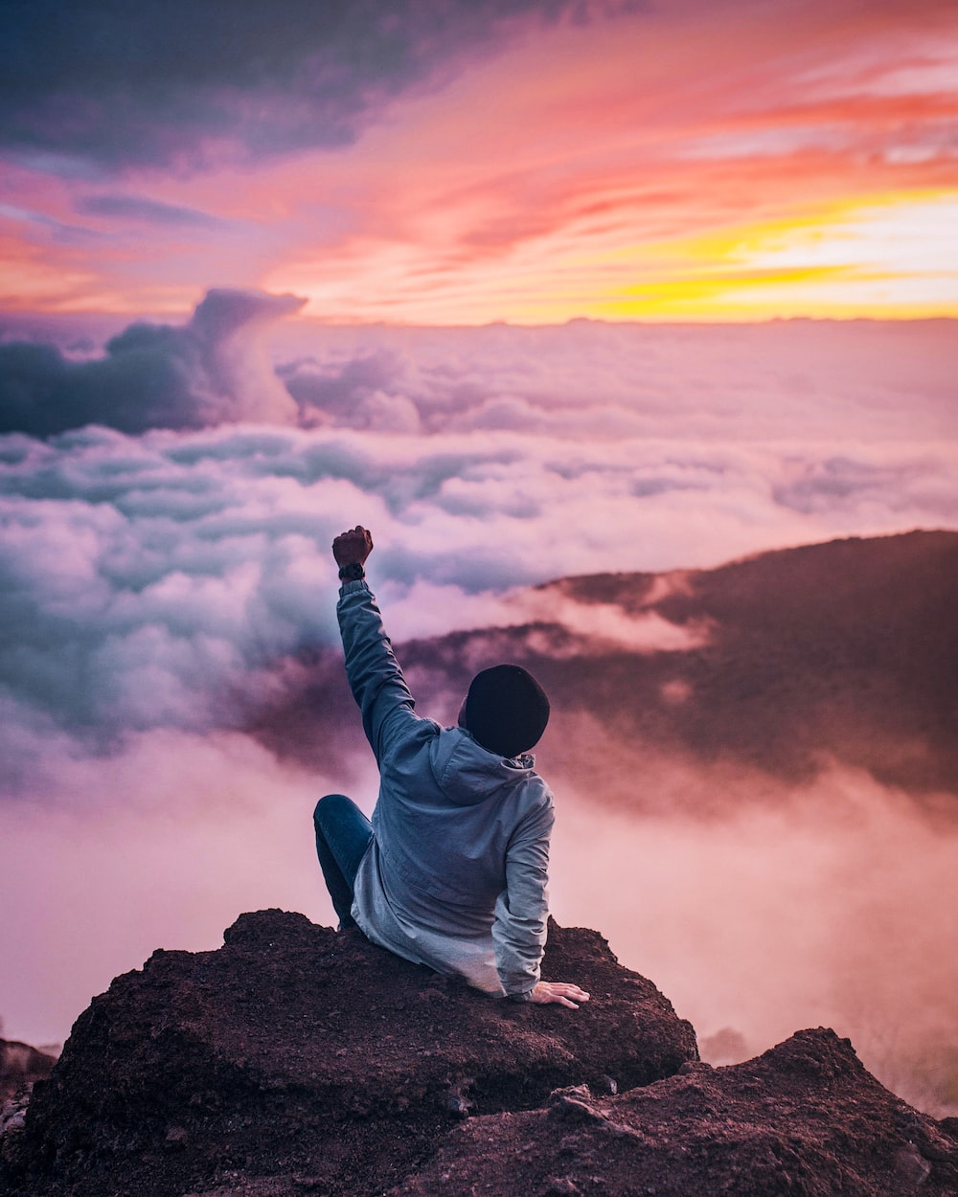
Business Requirements
Chrome Extension Planning Business Requirements & Success Factors
Javascript compatible model (serverless)
Speed
Model pretrained with relevant dataset
Success Factors
Model accuracy above 70%
Functioning chrome extension

Slide 18


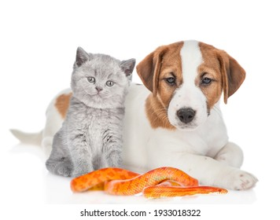
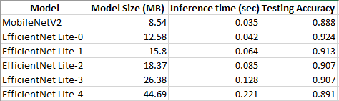
Fulfilling Business Requirements
MobileNet V2
JavaScript Requirement
Relevant Pretrained Dataset
Speed

Slide 19
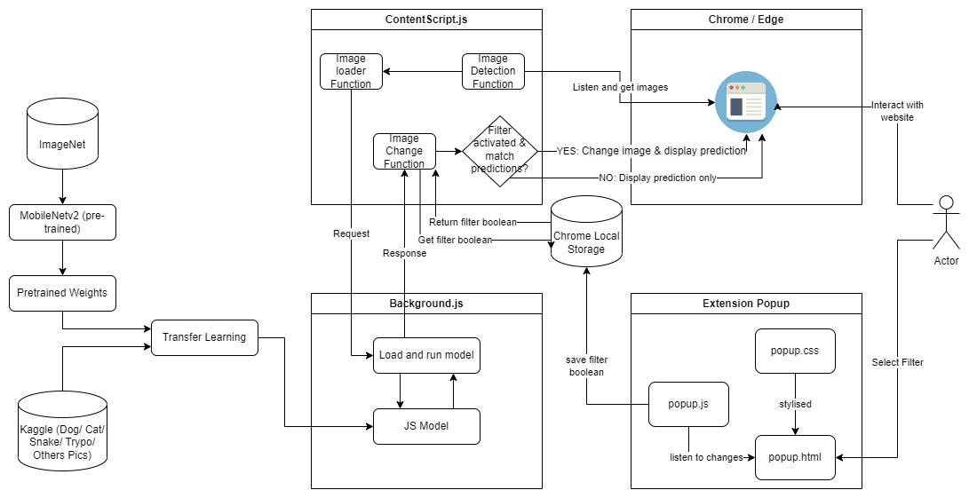
Model Architecture

Slide 20
Metrics
Hidden Layers | Regularisation | Validation Loss* | Validation Accuracy
1 | None | 0.1402 | 0.9586
1 | EarlyStopping | 0.1570 | 0.9603
2 | EarlyStopping, Dropout | 0.1533 | 0.9522
* Loss Function: categorical_crossentropy

Slide 21

Chrome Extension
Showcase
Notes:
Dogs: https://www.instagram.com/spcasgadopt/
Snake: https://www.straitstimes.com/singapore/environment/python-removed-from-traffic-junction-near-waterway-point-in-punggol
Trypophobia: https://dangerousminds.net/comments/apparently_trypophobia_a_fear_of_tiny_clusters_of_holes_isnt_a_phobia_but_a

Slide 22

CHROME / EDGE EXTENTION
Capability
Allow user selection of picture categories to hide
Works with asynchronous loaded pictures
Showcase
Dogs: https://www.instagram.com/spcasgadopt/
Snake: https://www.straitstimes.com/singapore/environment/python-removed-from-traffic-junction-near-waterway-point-in-punggol
Trypophobia: https://dangerousminds.net/comments/apparently_trypophobia_a_fear_of_tiny_clusters_of_holes_isnt_a_phobia_but_a
Limitations
Only work with images bigger than 128 * 128
Only process image after they are loaded
Do not work with multioutput per picture

Slide 23
Our Capabilities
Chrome Extension
Streamlit Post-Processing Image Filter
Streamlit Post-Processing Video Filter
(Image Classification)
Hide images and gif that you choose not to see.
Dogs
Cats
Snakes
Trypophobia
(Instance Segmentation)
Identify images of snakes by pixel and filter them out
(Instance Segmentation)
Identify images of snakes in a video by pixel and filter them out
Chrome Extension
Streamlit Web App

Slide 24

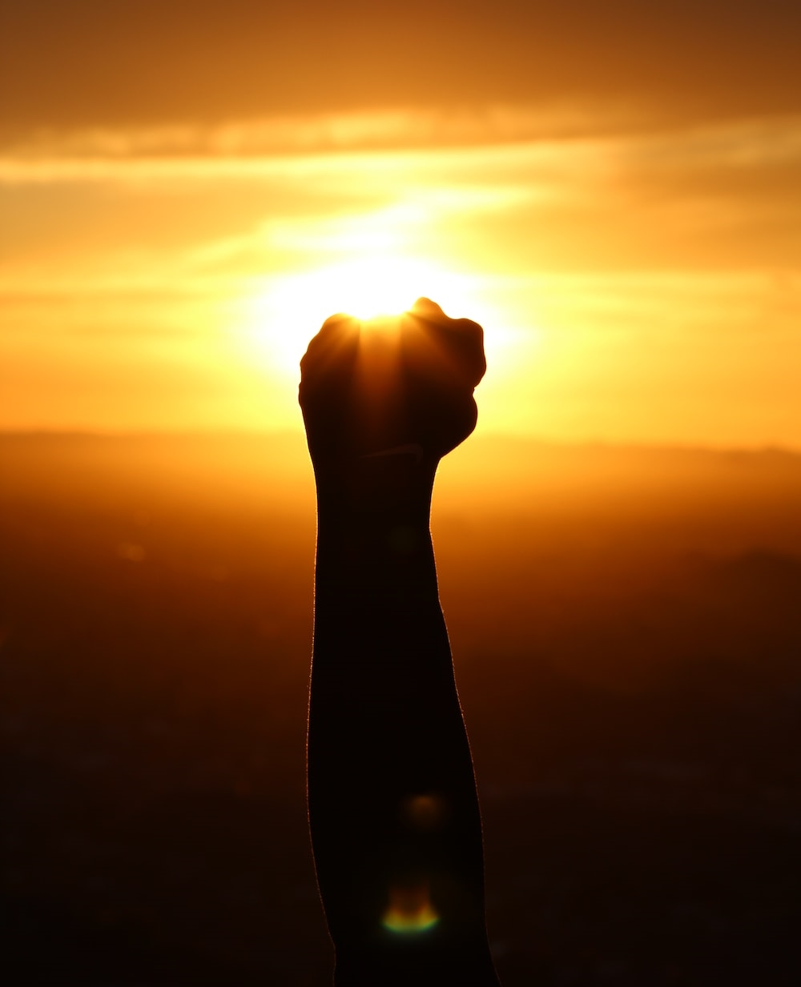
Business Requirements
Streamlit Planning Business Requirements & Success Factors
Balance between Speed and Accuracy
Model should work on both images and videos
Success Factors
Bounding Box Precision > 0.7
Mask Precision > 0.7
Functioning Streamlit

Slide 25

Fulfilling Business Requirements
YOLOv7
Works on Images & Videos
Speed & Accuracy
PWC Categories | Model | FPS | Mask AP
Real-time Instance Segmentation | SparseInst-608 | 40 | 37.9
Video Instance Segmentation | IDOL | 17.6 | 64.3
Real-Time Object Detection | YOLOv7-E6E | 36 | 64.0
Notes:
Relies on the backbone of opencv
Best balance between speed and accuracy

Slide 26

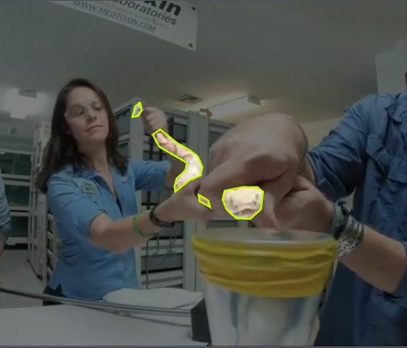
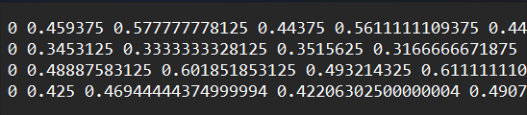
Data Preparation
Output Label (YOLOv7 format)
Class
Polygon Coordinates
Example of mask segmentation annotation. Green border denotes polygon coordinates
Notes:
Before we move on to training, we have to annotate our images and we use roboflow, a web app to do that.
Annotation is slightly more complicated.
As you can see on the image, you have to identify pixel by pixel where the snakes are on your image

Slide 27
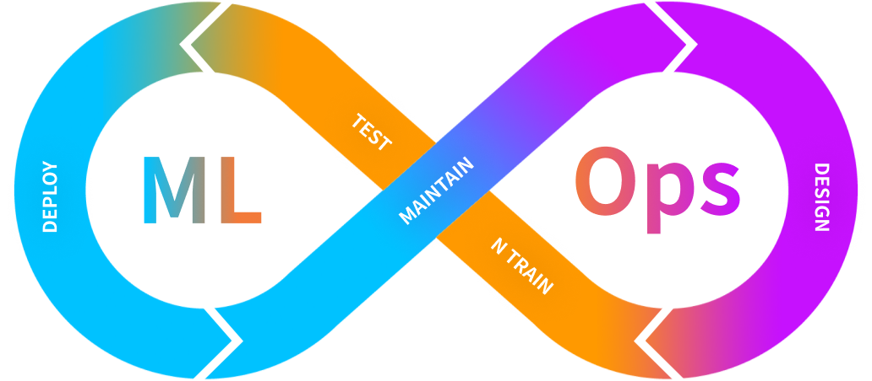
MLOps Workflow
3. Deployment
1. EDA / Data Preparation
4. Active Learning
2. Training / Testing
Deployment on streamlit
- Ensure minimum image size
- Data Annotation using Roboflow
-Images less than threshold would be sent back to Roboflow for human annotation
- Retraining with updated dataset
- Setting up environment on Kaggle
- Utilising pre-trained YOLOv7 weights
- Train using custom annotated dataset
- Logged result on Wandb

Slide 28
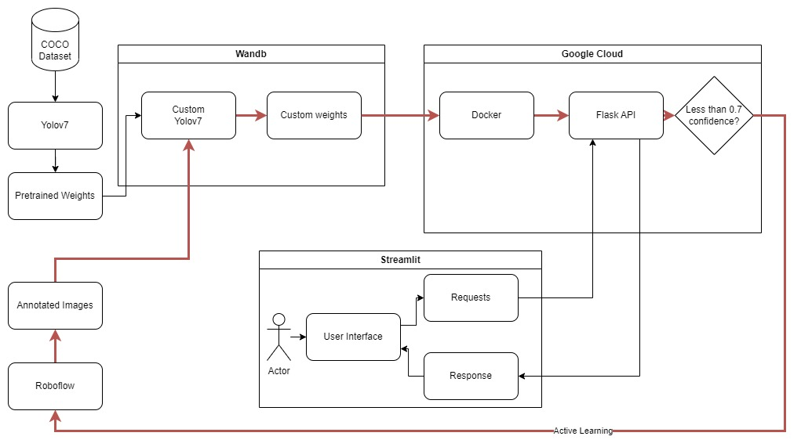
Model Architecture
Active Learning

Slide 29

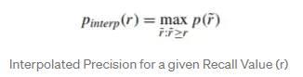
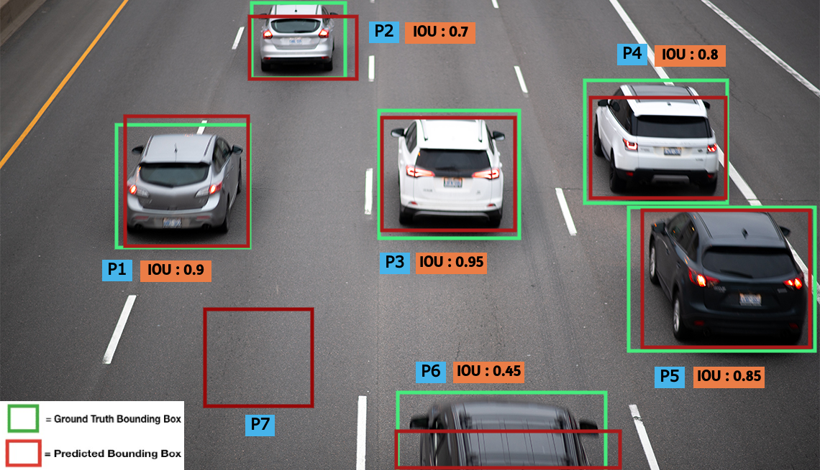
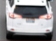
Metric Explanation AP
Intersection over Union
No | TP/FP/FN @ IoU 0.5 | Precision TP/(TP+FP)) | Recall TP/(TP+FN)) | Precision_interp
P1 | TP | 1/1 = 1 | 1/4 = 0.25 | 1
P2 | TP | 2/2 = 1 | 2/5 = 0.4 | 1
P3 | TP | 3/3 = 1 | 3/6 = 0.5 | 1
P4 | FN | 3/3 = 1 | 3/6 = 0.5 | 1
P5 | FP | 3/4 = 0.75 | 3/6 = 0.5 | 1
P6 | FP | 3/5 = 0.6 | 3/6 = 0.5 | 1
P7 | TP | 4/6 = 0.67 | 4/7 = 0.57 | 0.67
car
car
car
car
car
horse
FN: Wrong class or no predictions
Notes:
https://towardsdatascience.com/breaking-down-mean-average-precision-map-ae462f623a52

Slide 30
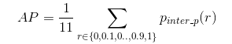

Metric Explanation AP
No | TP/FP/FN @ IoU 0.5 | Precision TP/(TP+FP)) | Recall TP/(TP+FN)) | Precision_interp
P1 | TP | 1/1 = 1 | 1/4 = 0.25 | 1
P2 | TP | 2/2 = 1 | 2/5 = 0.4 | 1
P3 | TP | 3/3 = 1 | 3/6 = 0.5 | 1
P4 | FN | 3/3 = 1 | 3/6 = 0.5 | 1
P5 | FP | 3/4 = 0.75 | 3/6 = 0.5 | 1
P6 | FP | 3/5 = 0.6 | 3/6 = 0.5 | 1
P7 | TP | 4/6 = 0.67 | 4/7 = 0.57 | 0.67
= $\frac{1}{11}(1+1+1+1+1+1+0.67+0.67+0.67+0.67+0.67$
AP
$$≈0.85$$
mAP: Average AP for all classes and images
Notes:
https://towardsdatascience.com/breaking-down-mean-average-precision-map-ae462f623a52.
https://towardsdatascience.com/map-mean-average-precision-might-confuse-you-5956f1bfa9e2

Slide 31
Active Learning Metrics
YOLOv7 Mask AP: 0.64
YOLOv7 Box AP : 0.51
Round | No of Training Images* | No of Validation Images | Weights | mAP_0.5 (B) | mAP_0.5 (M) | Precision | No of Testing Images | No of Testing Images send for annotate below 70% confidence *
1 | 543 | 55 | Yolov7 weight | 0.4436 | 0.4127 | 0.7289 | 1000 | 100
2 | 843 | 55 | Yolov7 weight | 0.4389 | 0.4504 | 0.7891 | 1000 | 100
3 | 1196 | 55 | weight from R2 | 0.4535 | 0.4602 | 0.7558 | 1000 | 100
4 | 1413 | 75 | weight from R3 | 0.5372 | 0.5396 | 0.8639 | 1000 | 100
*Only the first 100 images are annotated

Slide 32
Active Learning Metrics
Round | No of Training Images* | No of Validation Images | Weights | Box Precision | Mask Precision | No of Testing Images | No of Testing Images send for annotate below 70% confidence *
1 | 543 | 55 | Yolov7 weight | 0.7168 | 0.7289 | 1000 | 100
2 | 843 | 55 | Yolov7 weight | 0.7891 | 0.8334 | 1000 | 100
3 | 1196 | 55 | weight from R2 | 0.7255 | 0.7558 | 1000 | 100
4 | 1413 | 75 | weight from R3 | 0.8312 | 0.8639 | 1000 | 100
*Only the first 100 images are annotated

Slide 33
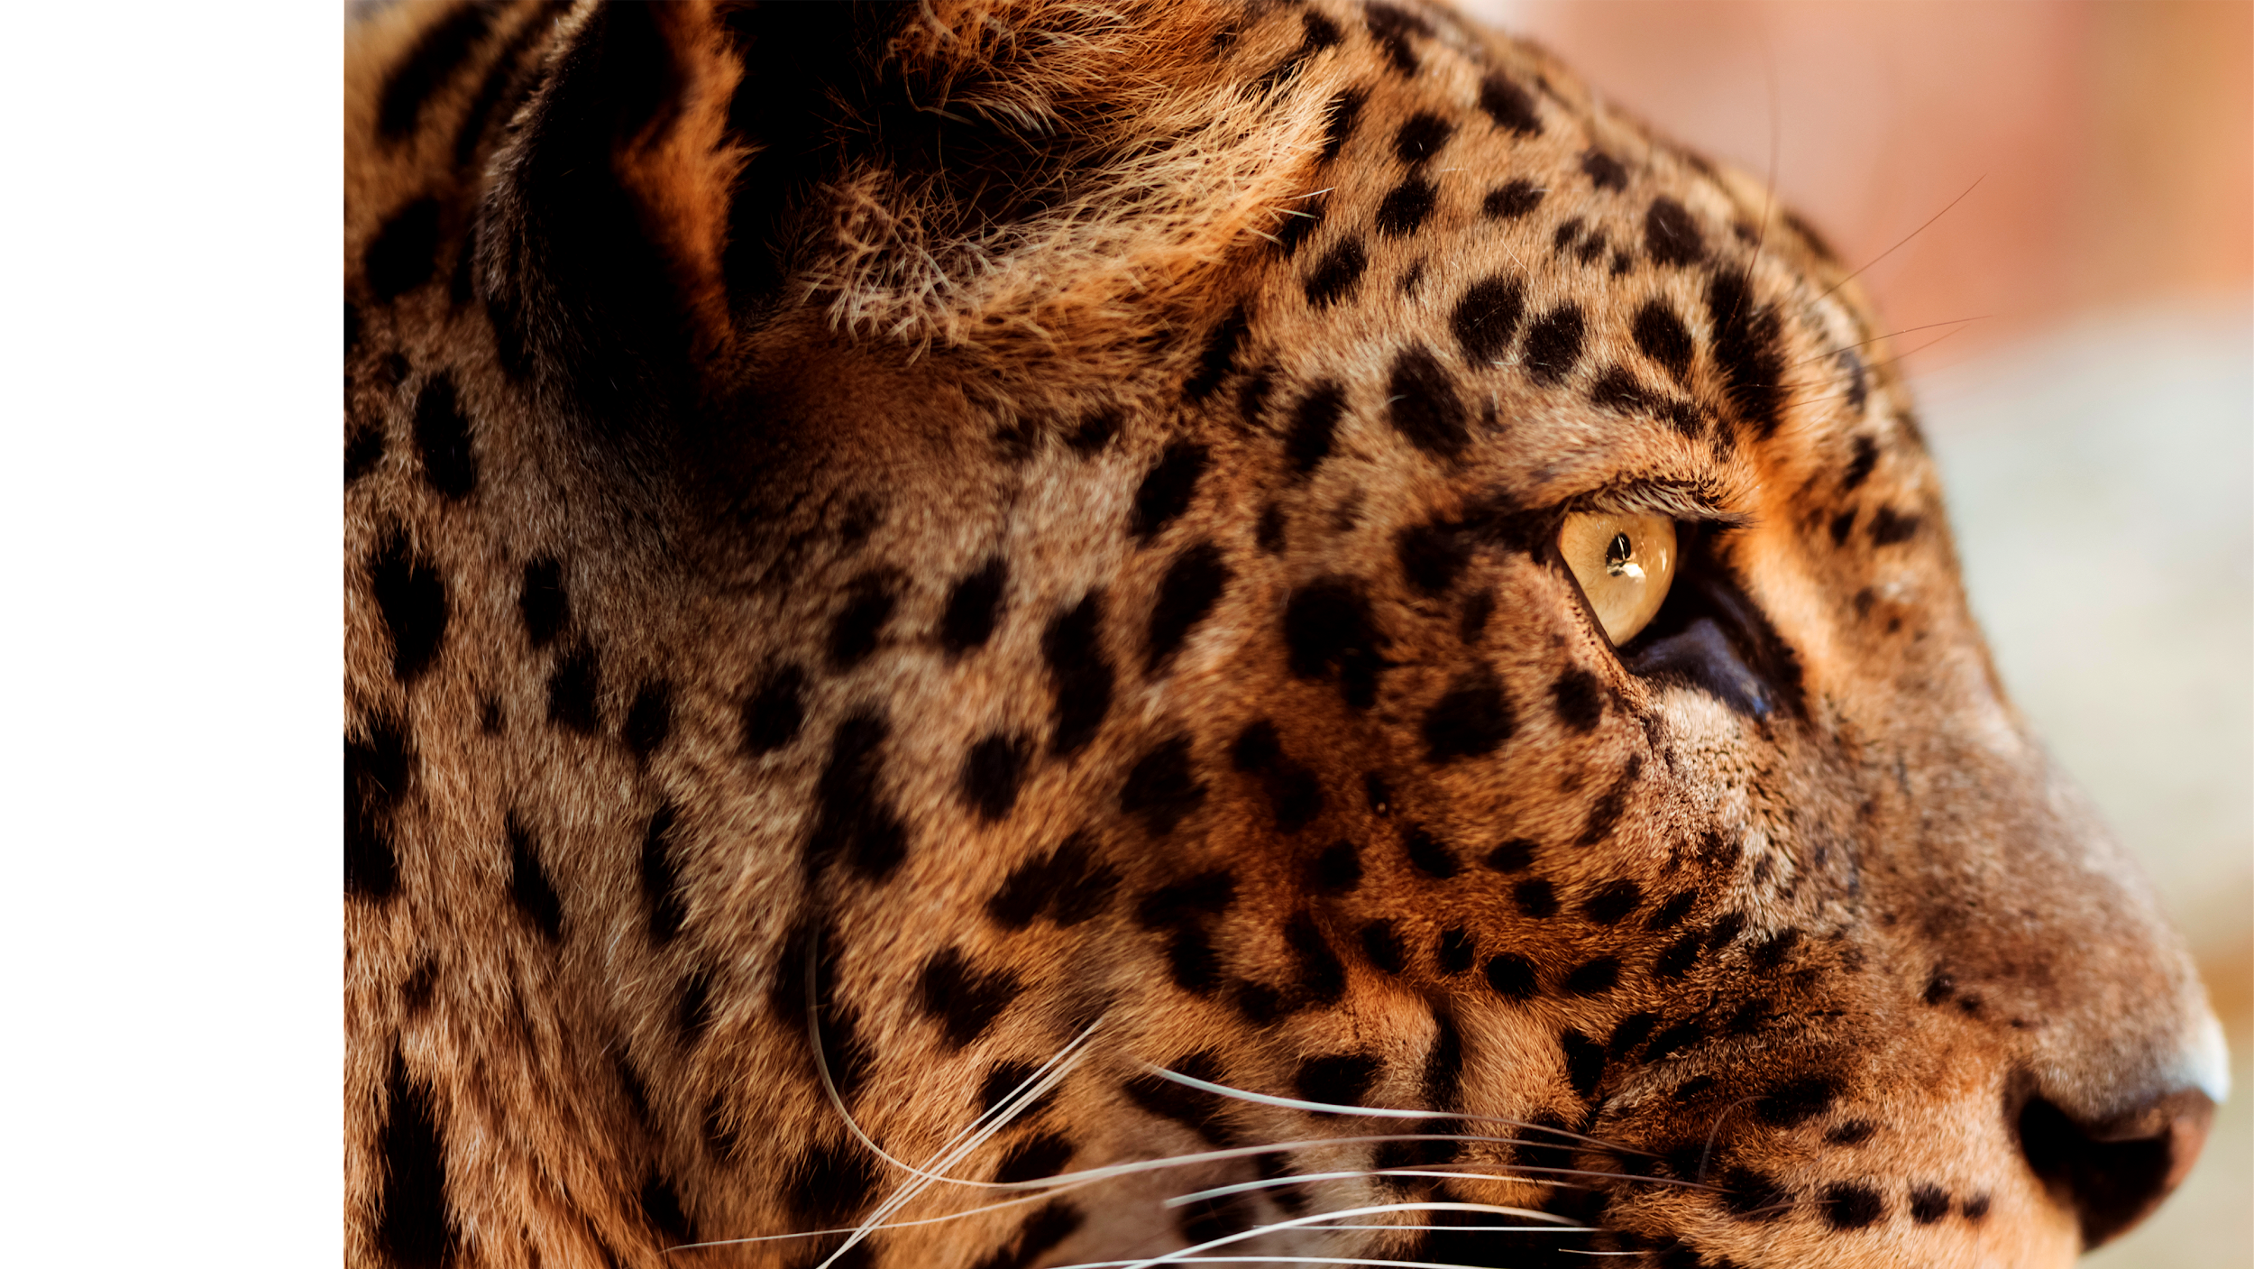

Streamlit
SHOWCASE
https://bit.ly/3g96L3J
Notes:
Pic: https://cdn.britannica.com/34/181134-050-3080D1C4/Eastern-brown-snake.jpg
Pic: https://www.bleepstatic.com/content/hl-images/2021/10/29/green_snake.jpg
Gif: https://media2.giphy.com/media/2wV2Jc6QFkAhm3cfej/giphy.gif

Slide 34
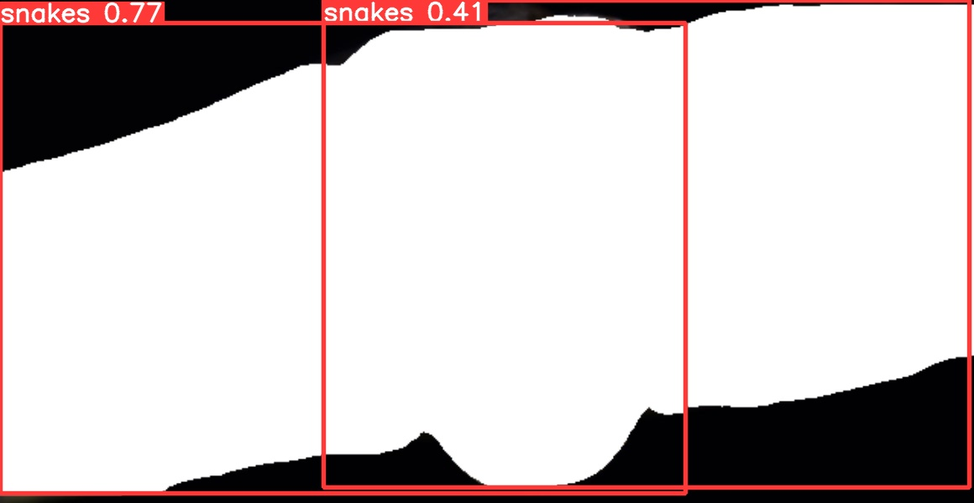
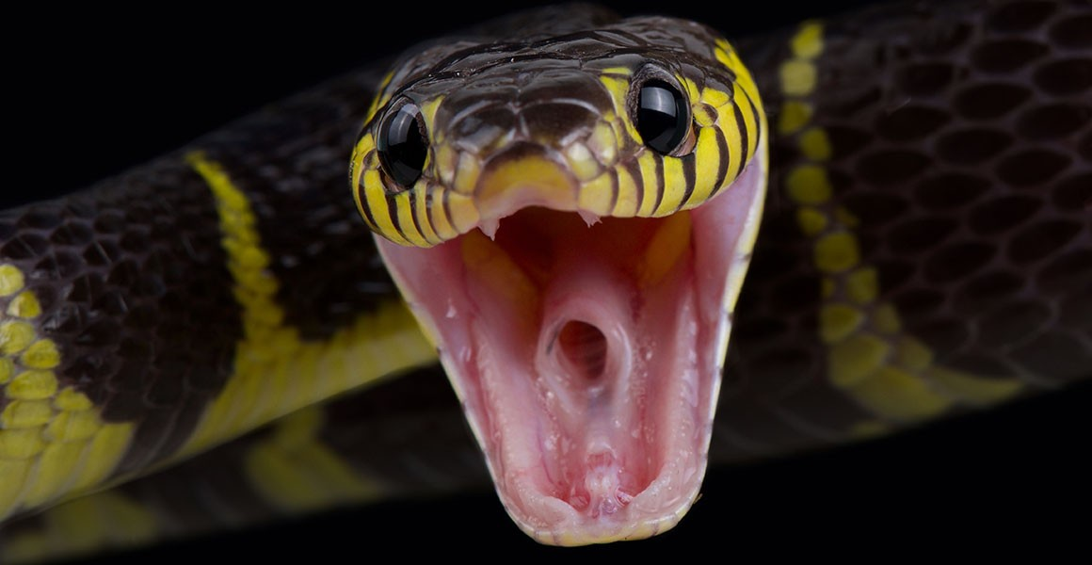
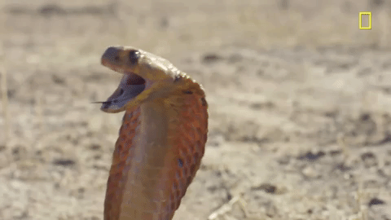
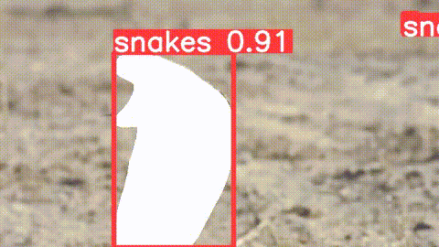
Streamlit
Showcase
Showcase
Streamlit
Before
Before
After
After
Limitations
mAP needs to be improved to include more training images
Slow processing due to no GPU and no saved instance activated for GCP
Instance Segmentation is done frame by frame without consideration of previous and next frames
Allow real time streaming of output logs from model to Streamlit

Slide 35
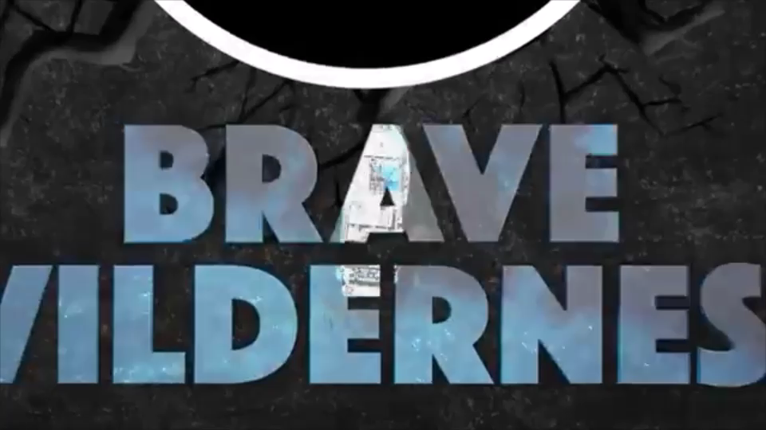
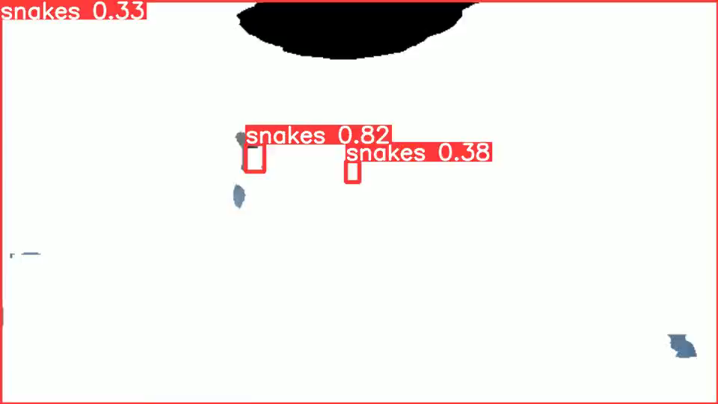
Video Segmentation Example
Before
After
Source: Deadliest Job in America - Snake Milker! - YouTube

Slide 36
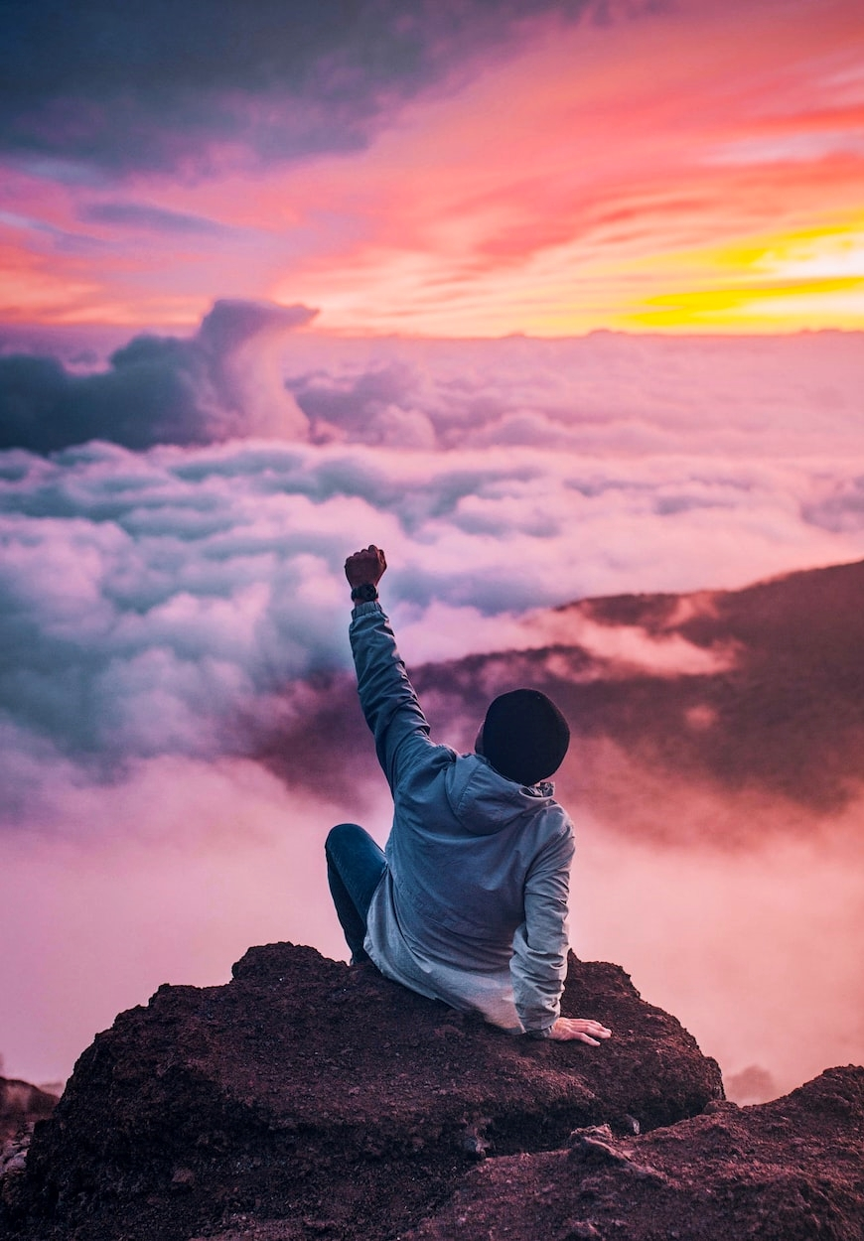
CONCLUSION
Success Factors Evaluation
Tasks | Factors | Outcomes
Image Classification | Validation Image Accuracy > 70% | 0.9586
Image Classification | Functioning Chrome Extension | Yes
Instance Segmentation | Precision(B) | 0.8312
Instance Segmentation | Precision(M) | 0.8639
Instance Segmentation | Functioning Streamlit App | Yes

Slide 37
Recommendations
3 Prong Approach
Government Regulations through laws and ISP blacklist
Always rely on multiple redundancies to perform our task reliabily and effectively
Opensource URL blacklist
(GitHub)
ViShield
Notes:
https://github.com/StevenBlack/hosts/blob/master/alternates/porn/readme.md
https://github.com/PeterDaveHello/threat-hostlist

Slide 38
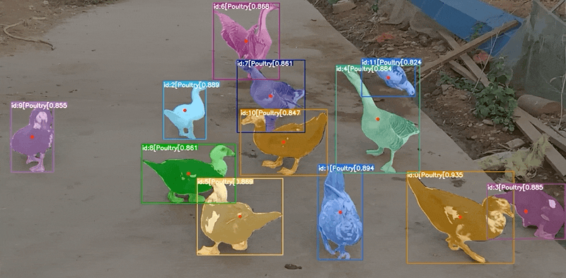

Future Steps
Continue to improve on Instance Segmentation results
Explore deeper on video instance segmentation such as IDOL
Expand feature to allow segmentation on YouTube or Live Stream
Expand filters to include negative sentiment texts, car plates, road sign

Slide 39
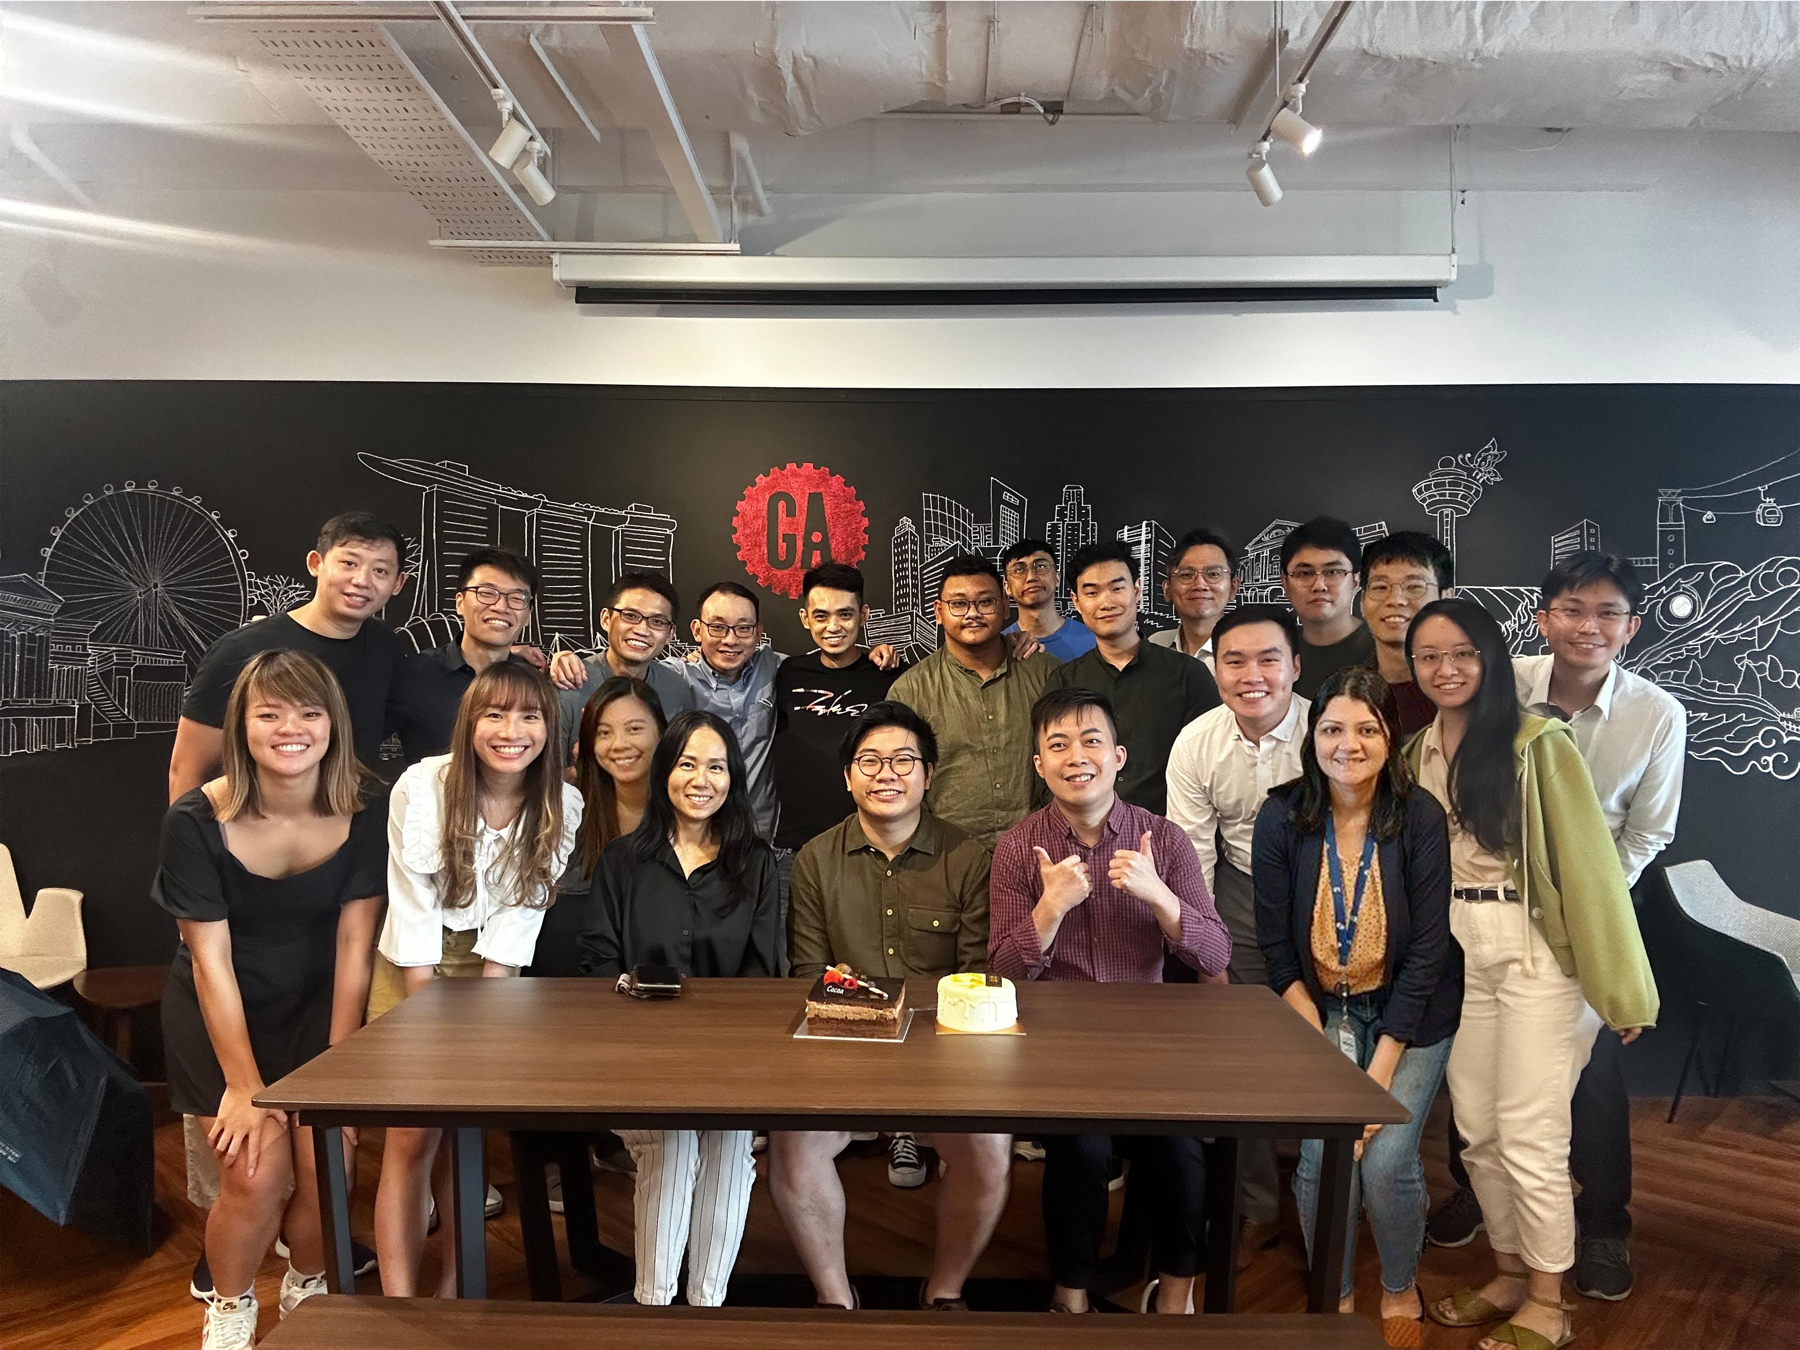
THANKS
Er Jie Yong erjieyong@gmail.com
Special Thanks:
Shilpa, Instructor

